Slide 1
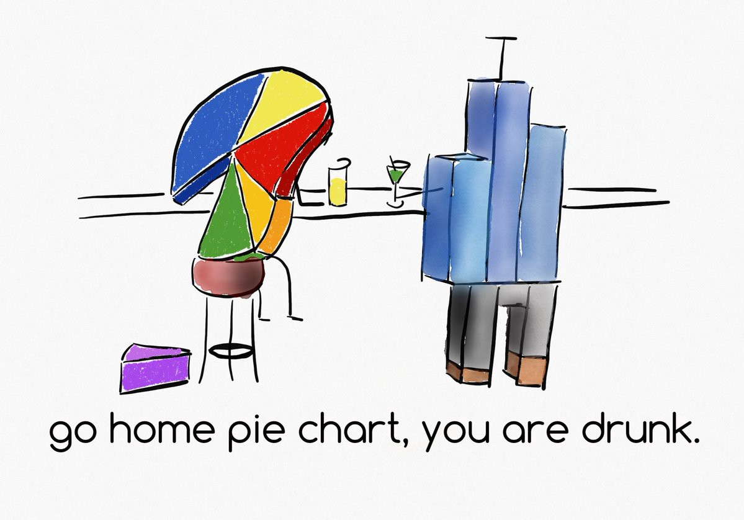


Visualization
MSc. Kian Jenab
PhD student
Devision of Terrestrial Ecosystem Research
Centre for Microbiology and Environmental Systems Science
University of Vienna
Email: kian.jenab@univie.ac.at

Slide 2
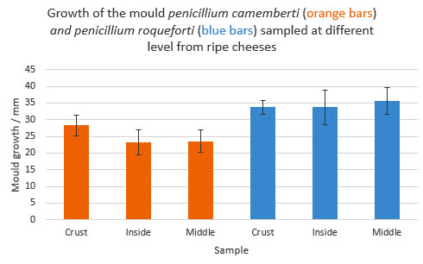
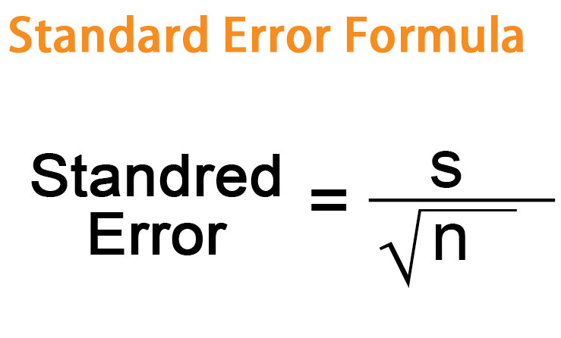
Bar Chart

Slide 3
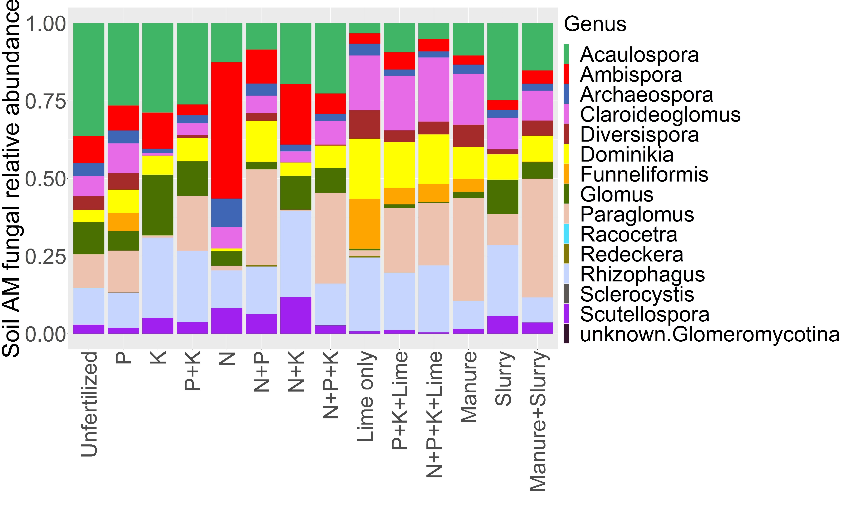
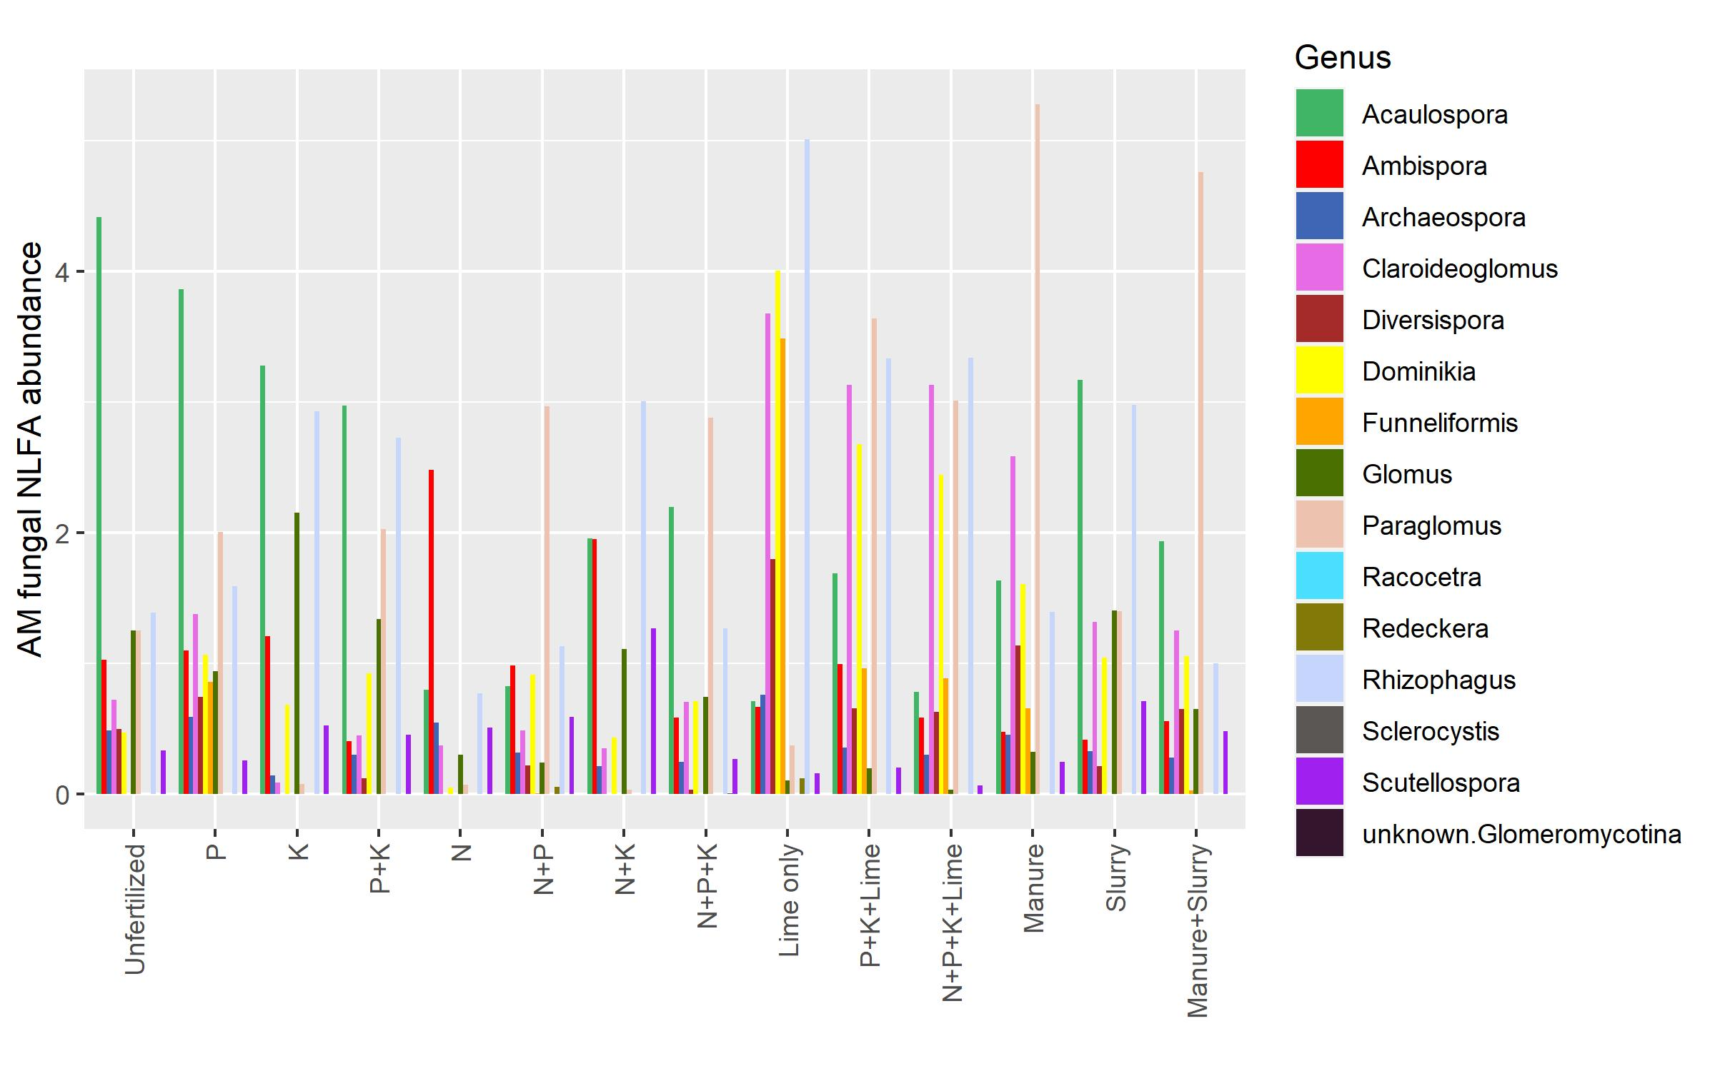
Stacked Bar Chart

Slide 4
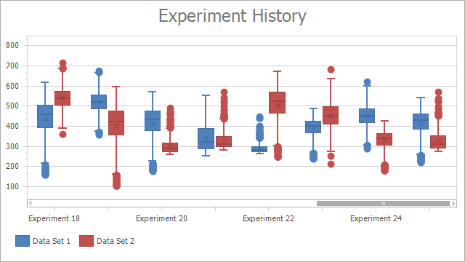
Box-Plot

Slide 5
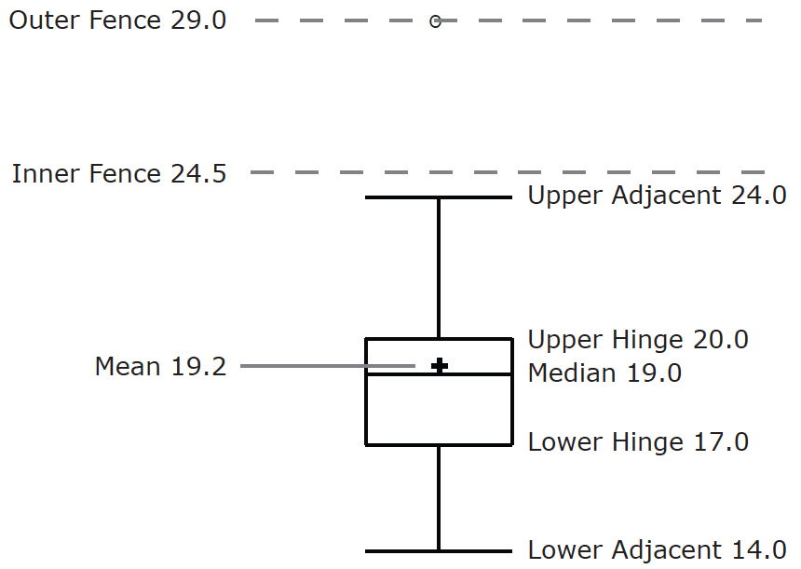
Box-plot
Name | Formula | Value
Upper Hinge | 75th Percentile | 20
Lower Hinge | 25th Percentile | 17
H-Spread | Upper Hinge - Lower Hinge | 3
Step | 1.5 x H-Spread | 4.5
Upper Inner Fence | Upper Hinge + 1 Step | 24.5
Lower Inner Fence | Lower Hinge - 1 Step | 12.5
Upper Outer Fence | Upper Hinge + 2 Steps | 29
Lower Outer Fence | Lower Hinge - 2 Steps | 8
Upper Adjacent | Largest value below Upper Inner Fence | 24
Lower Adjacent | Smallest value above Lower Inner Fence | 14
Outside Value | A value beyond an Inner Fence but not beyond an Outer Fence | 29
Far Out Value | A value beyond an Outer Fence | None

Slide 6
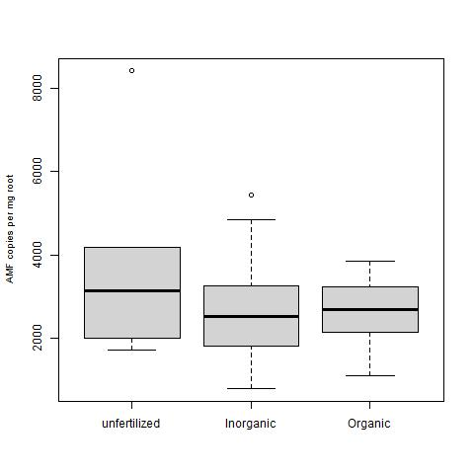
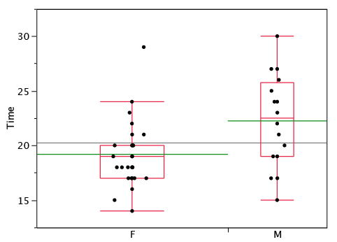
Box-plot

Slide 7
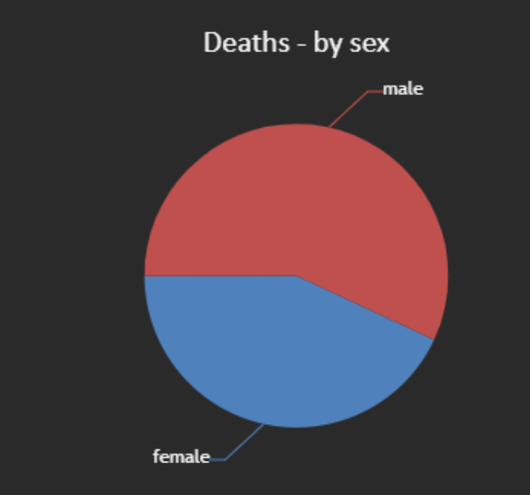
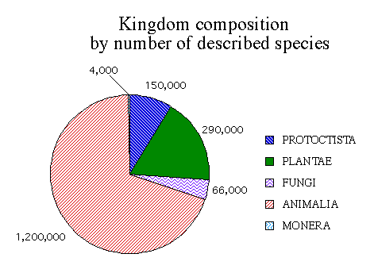
Pie Chart

Slide 8
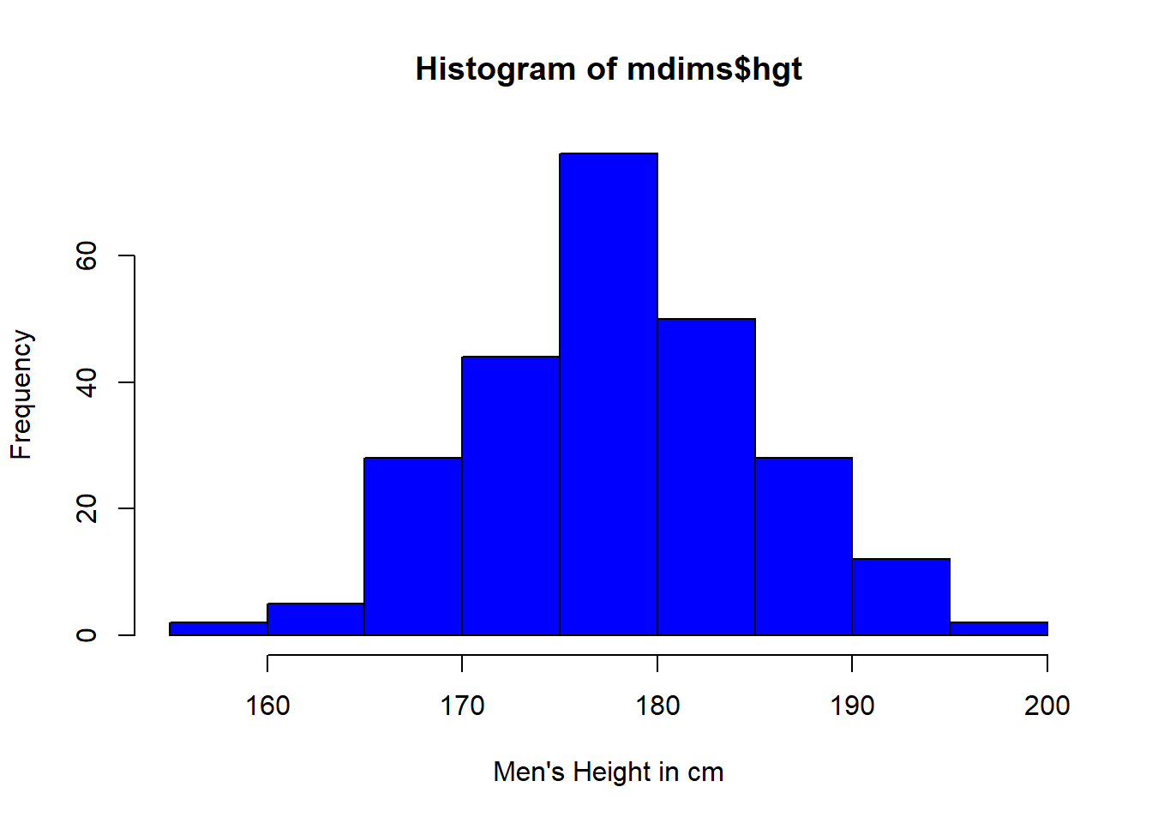
Histogram

Slide 9
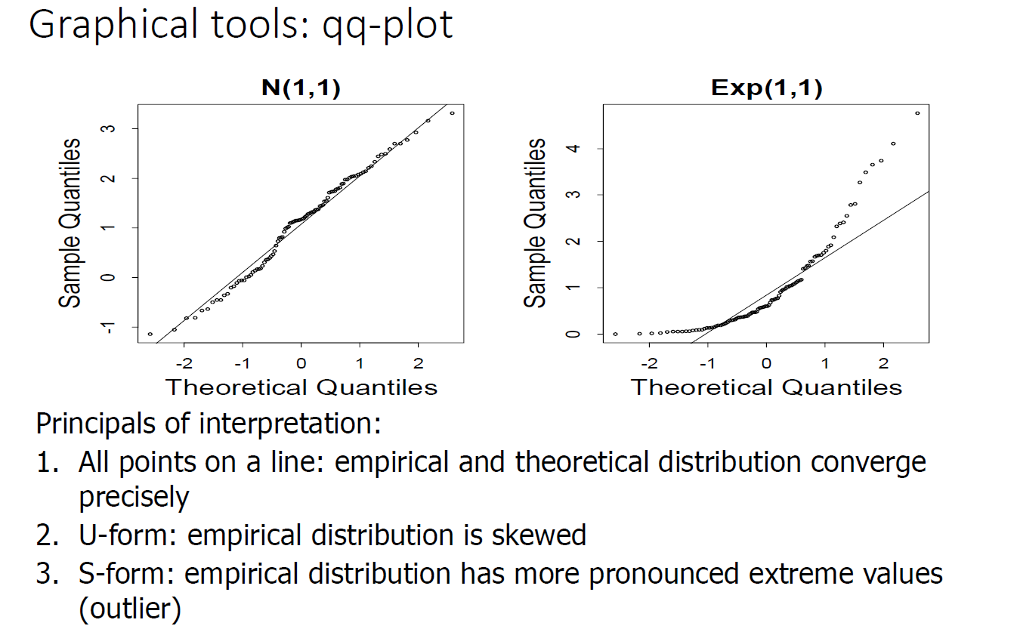
qq-plot

Slide 10
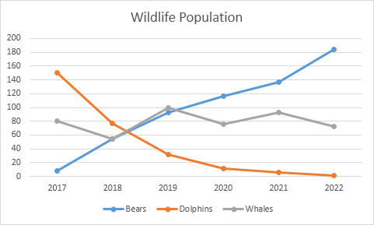
Line Graph

Slide 11
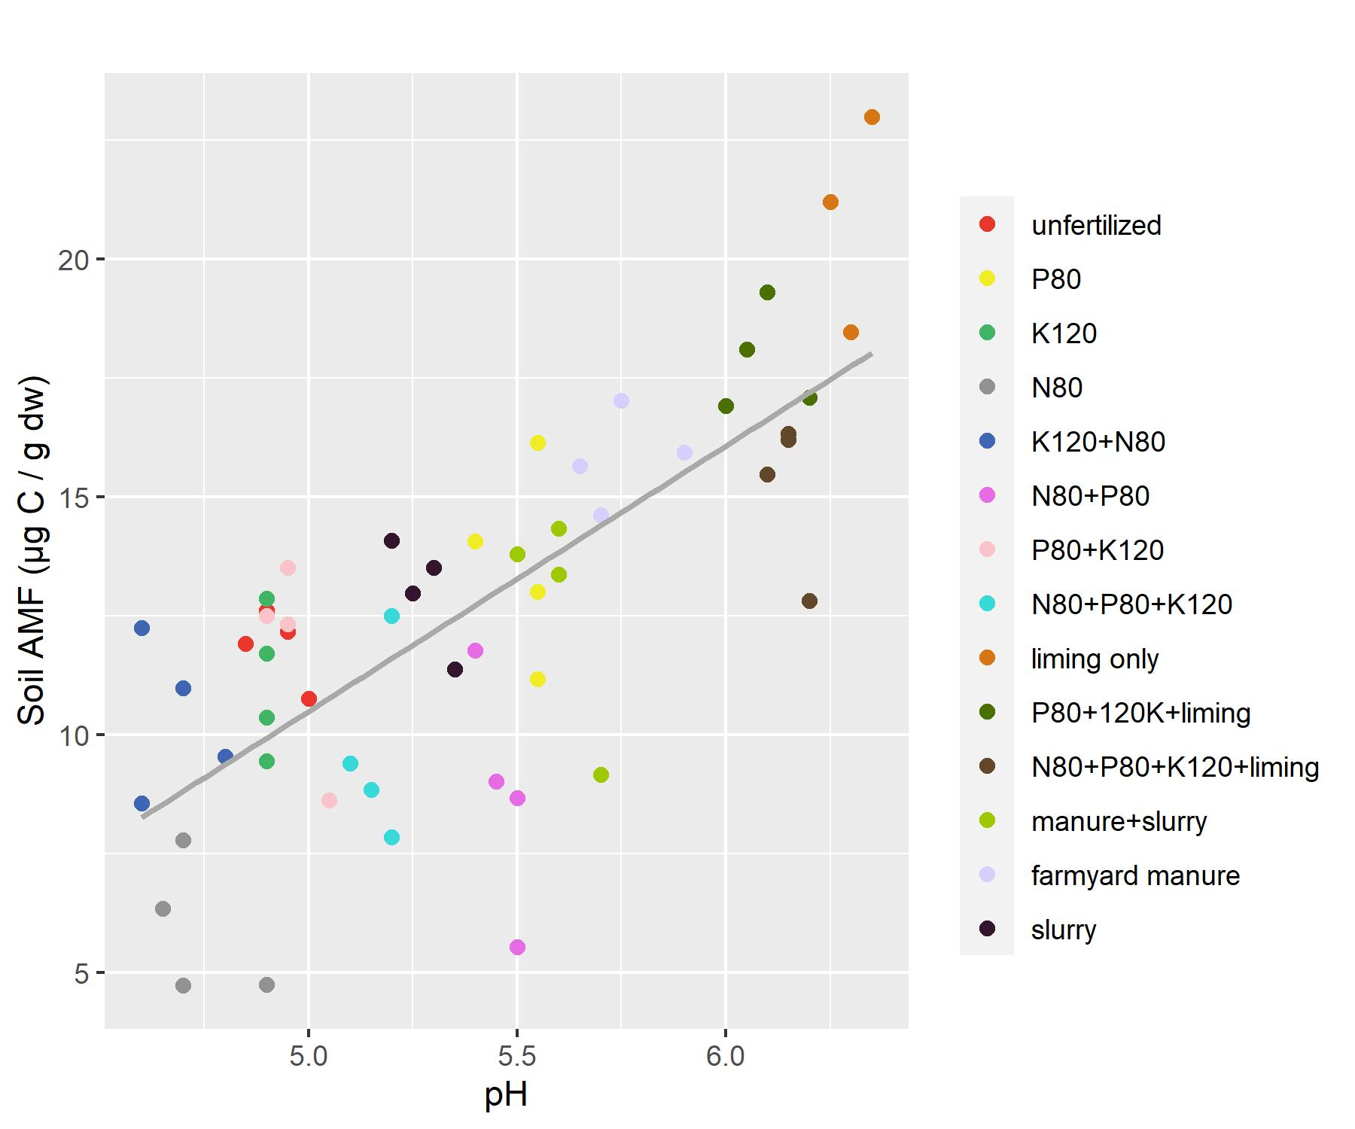
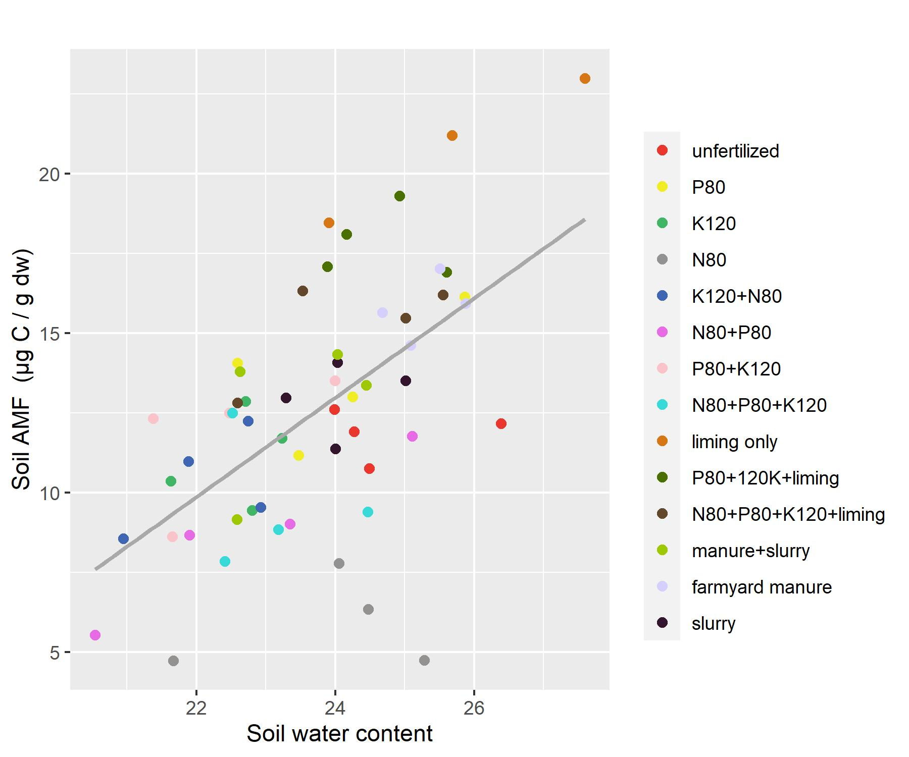
Scatter Plot
Soil AMF (ug NLFA-C / g dw)
R²= 0.54
P= 5.235e-5

Slide 12
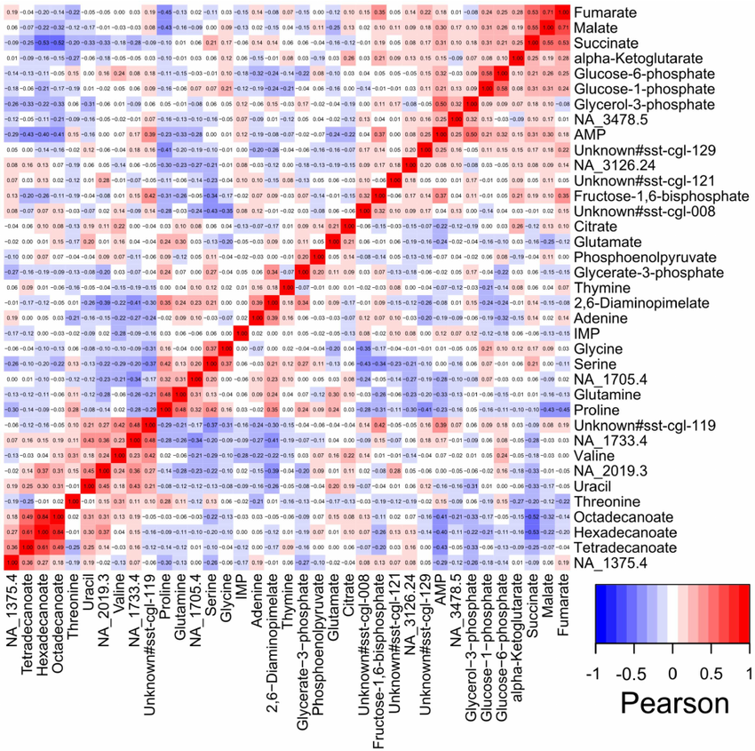
Heatmap

Slide 13
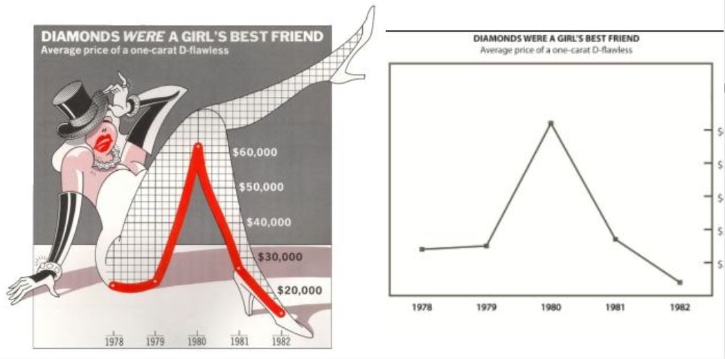
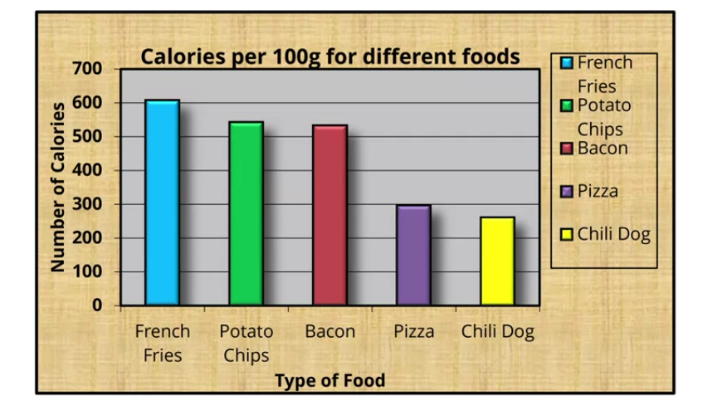
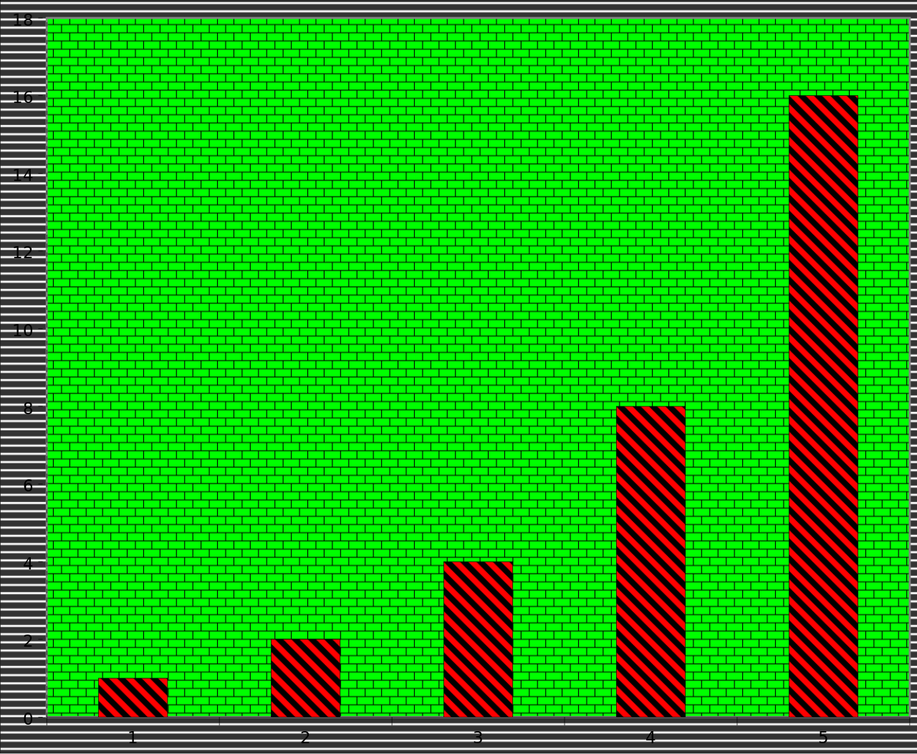
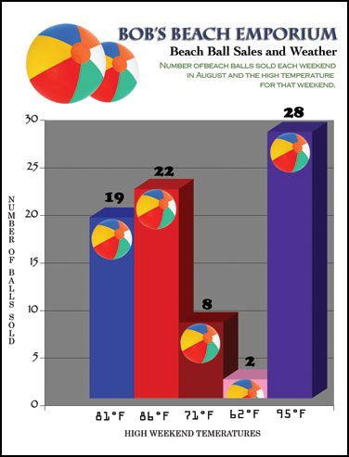
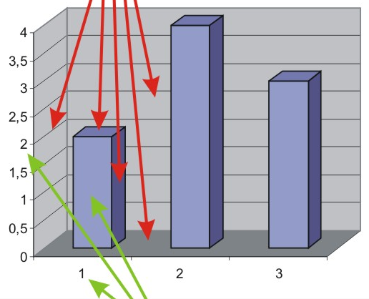
Chartjunk
Unnecessary elements in graphs

Slide 14
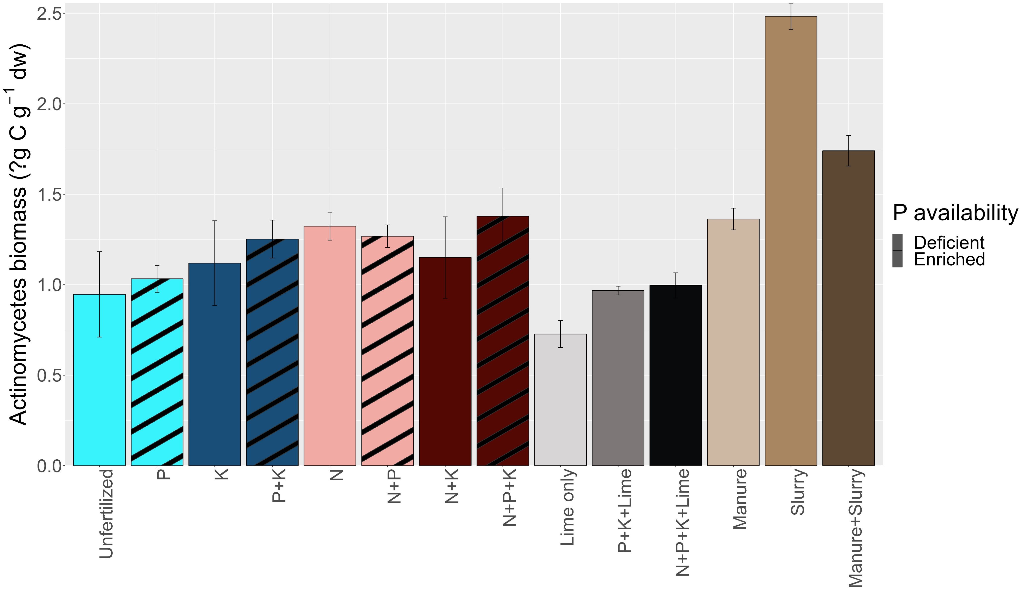
Color
Help to choose colors: https://medialab.github.io/iwanthue/

Slide 15
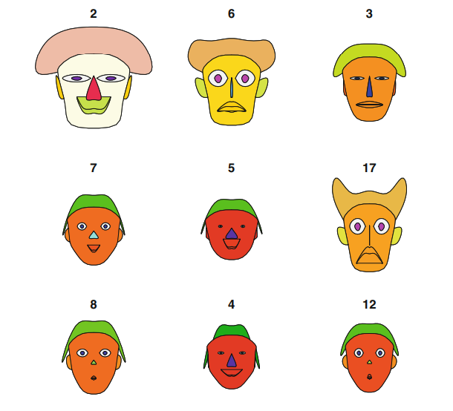
Made by “aplpack” package

